Slide 1

BPSO Literature Review: Establishing Therapeutic Relationships in Public Health
May 31, 2018
Sarah Molnar RN, BScN, MPH(c)

Slide 2
Agenda
Introduction/ Background
Literature Review Process
Workplan
Research questions
Search Terms
Next steps
Questions
Articles: Discussion
Evaluation and feedback

Slide 3

Introduction/ Background
Practicum student from University of Toronto, Dalla Lana School of Public Health
Research experience at both the undergraduate and graduate level
Volunteered on Dr. Robyn Plunkett’s project, “Understanding Women’s Health Promotion and Rural Canadian Churches”
Courses:
  Research Issues in Primary Care, Appraising and Applying Evidence to Assist Clinical Decision Making, Research Methodology, Elementary Statistics
Research proposals, evidence appraisal, narrative reviews, policy briefs, etc.

Slide 4


Slide 5
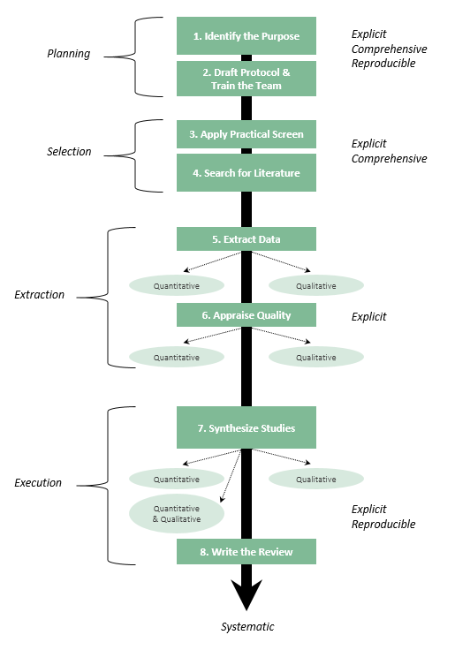
As of May 31, all 40 articles have been collected and saved within the Medline, CINAHL, and PyschInfo databases

Slide 6
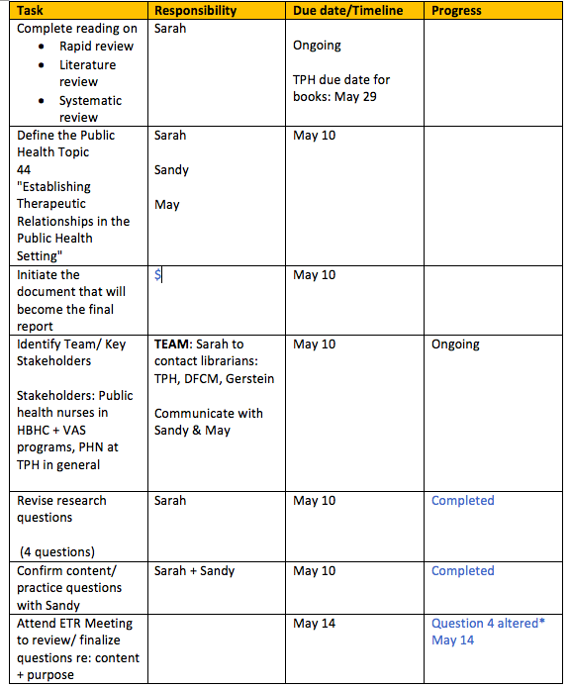
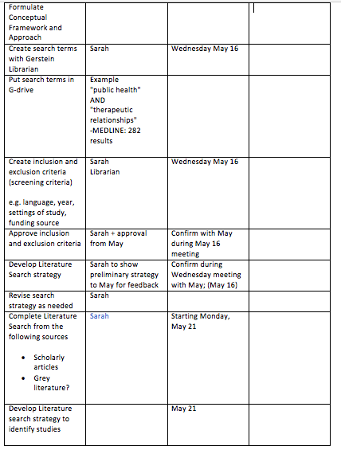
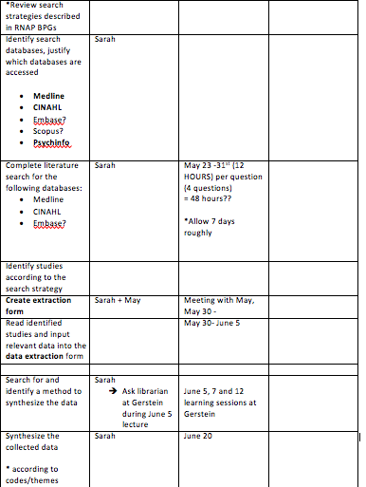
Workplan

Slide 7
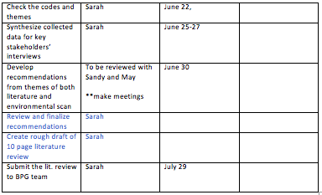

Whoa… that’s a lot of steps!!!
Why bother?...

Slide 8
Research Questions
What are the characteristics/components of a therapeutic professional-client relationship (TR) in public health setting?
How do these therapeutic relationships establish in public health setting?
What's the role and responsibilities of public health staff in establishing therapeutic relationships with clients?
What are some strategies that public health staff can adopt to establish relationships with vulnerable clients (homelessness, mental illness)

Slide 9
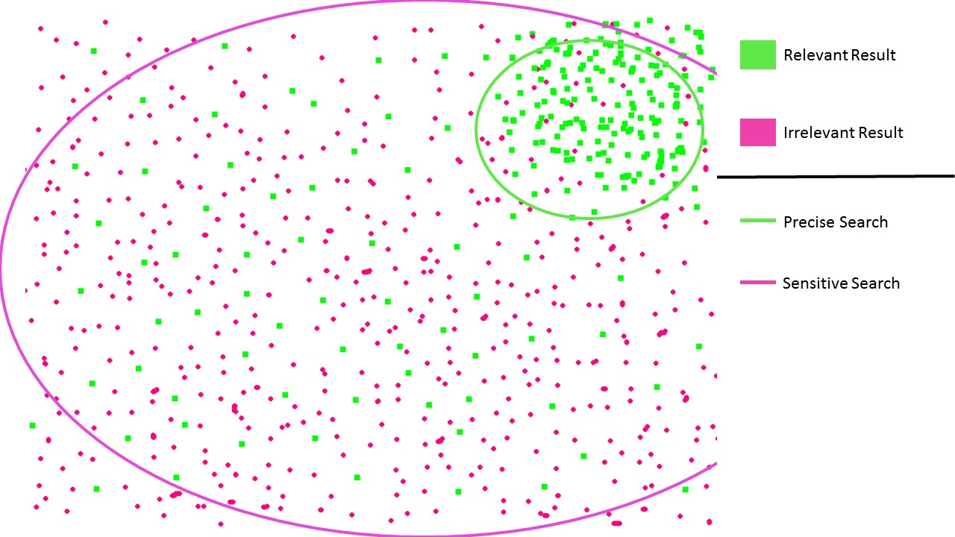
Sensitive vs. Precise

Slide 10
Search Terms
CINAHL
“nurses” OR ”public health nurse” OR “community health nurse”
AND
“nurse-patient relationship” OR “caregiver patient relationship”
MEDLINE
“public health”
AND
“nurse”
AND
“therapeutic relationship”
PSYCHINFO
”therapeutic processes”
AND
“public health” OR “community health”
AND
“public health nurses” OR “nurses”

Slide 11
Next step: Data Extraction

Slide 12
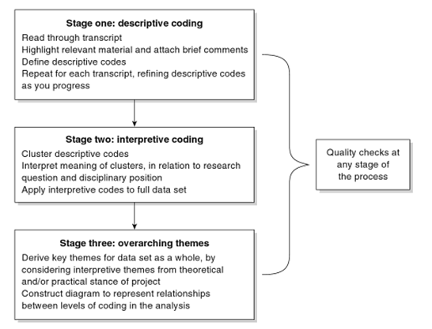
Data Extraction
Thematic coding
Microsoft excel to organize data

Slide 13

IT’S A QUESTION PARTY!

Slide 14
Articles & Discussion

